Slide 1

End To End Project On
IMDb Movie Recommendati0n System
Enhancing Movie Discovery for Every User.

Slide 2


Slide 3
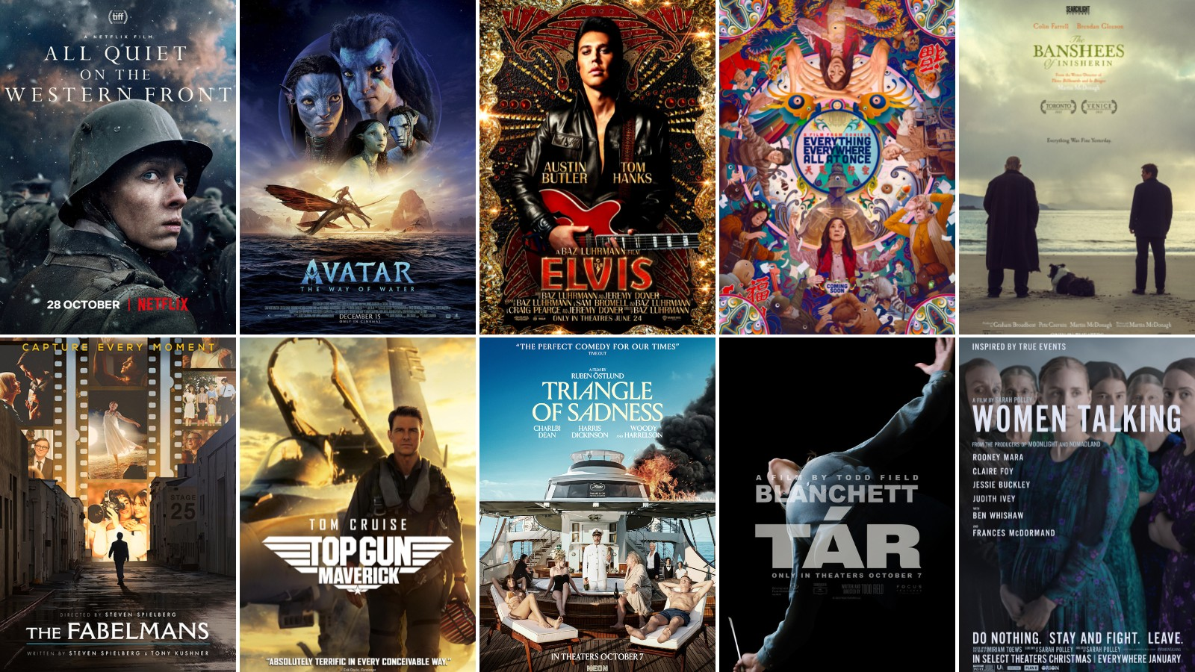


Slide 4

Presented By :
GROUP-3
Ms. Saloni Malpani
Mr. Sushil Saini
Mr. Sanket Nandurkar
Ms. Aparna Patode
Ms. Nandini Kumbhar
Ms. Shivani Ghuge
Mr. Pravin Kokne

Slide 5
INTRODUCTION
Recommendation System belongs to the class of Data Mining and Machine Learning.
A recommendation system tries to make predictions on user preferences and make recommendations which should interest customers. Recommendation systems are built for movies, books, communities, news articles etc.
Recommender systems are one of the most successful and widespread application of machine learning technologies in business.

Slide 6
AGENDA
Scraping data from the web using BeautifulSoup(Data Extraction)
Data Preprocessing
Exploratory Data Analysis (EDA)
Model Building
Streamlit Deployment
Conclusion

Slide 7
Business Objective
Scrape Movie dataset from IMDB, perform analysis for deeper insights and build a recommendation system.

Slide 8
DATA EXTRACTION
We have scraped the data for this project from the IMDB website (https://www.imdb.com/search/title/?title_type=feature&primary_language=en&ref_=adv_prv). It contains a list of movies based on current popularity.
This dataset should contain information about the top 5000 movies listed on IMDb, one of the most popular online databases of movies, TV shows, and celebrities. The data should include a variety of attributes such as movie name, release year, rating, gross income, votes, runtime, genre, certificate, description, directors, and stars. The dataset should be scraped and cleaned for research and analysis purposes

Slide 9
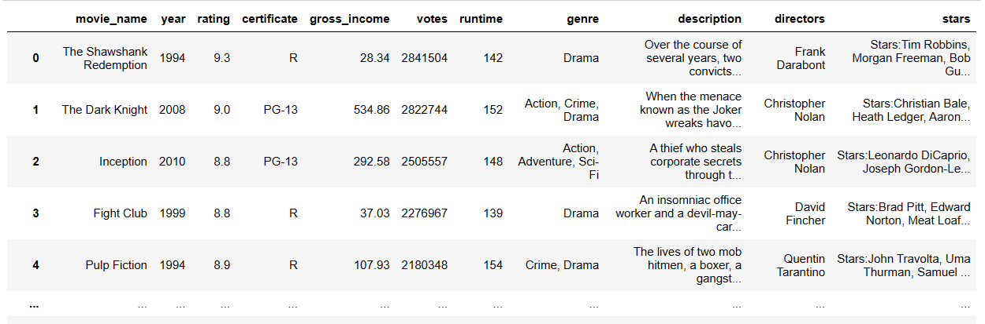
DATA PREPROCESSING
First we handling missing data
Changing the data types
Removing and replacing null values

Slide 10
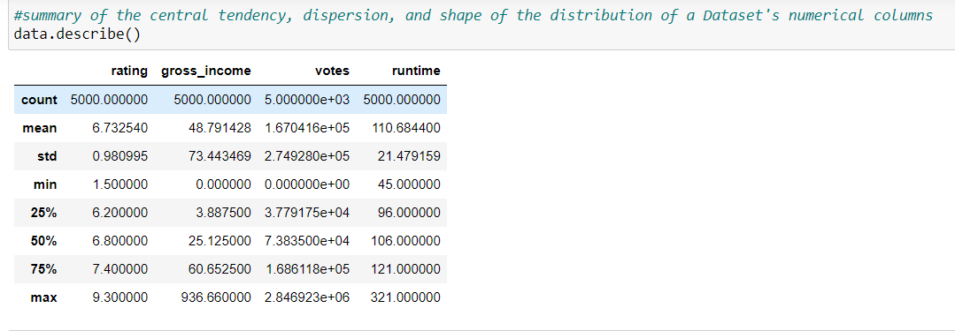
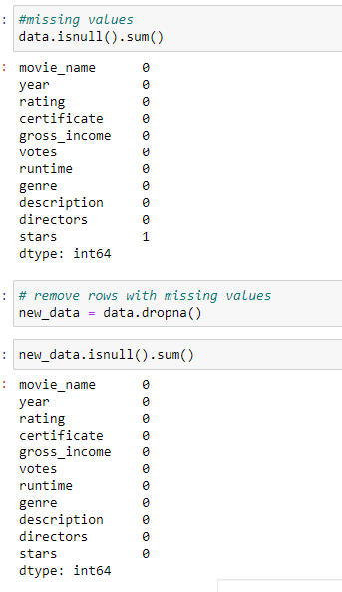
EXPLORATORY DATA ANALYSIS(EDA)

Slide 11
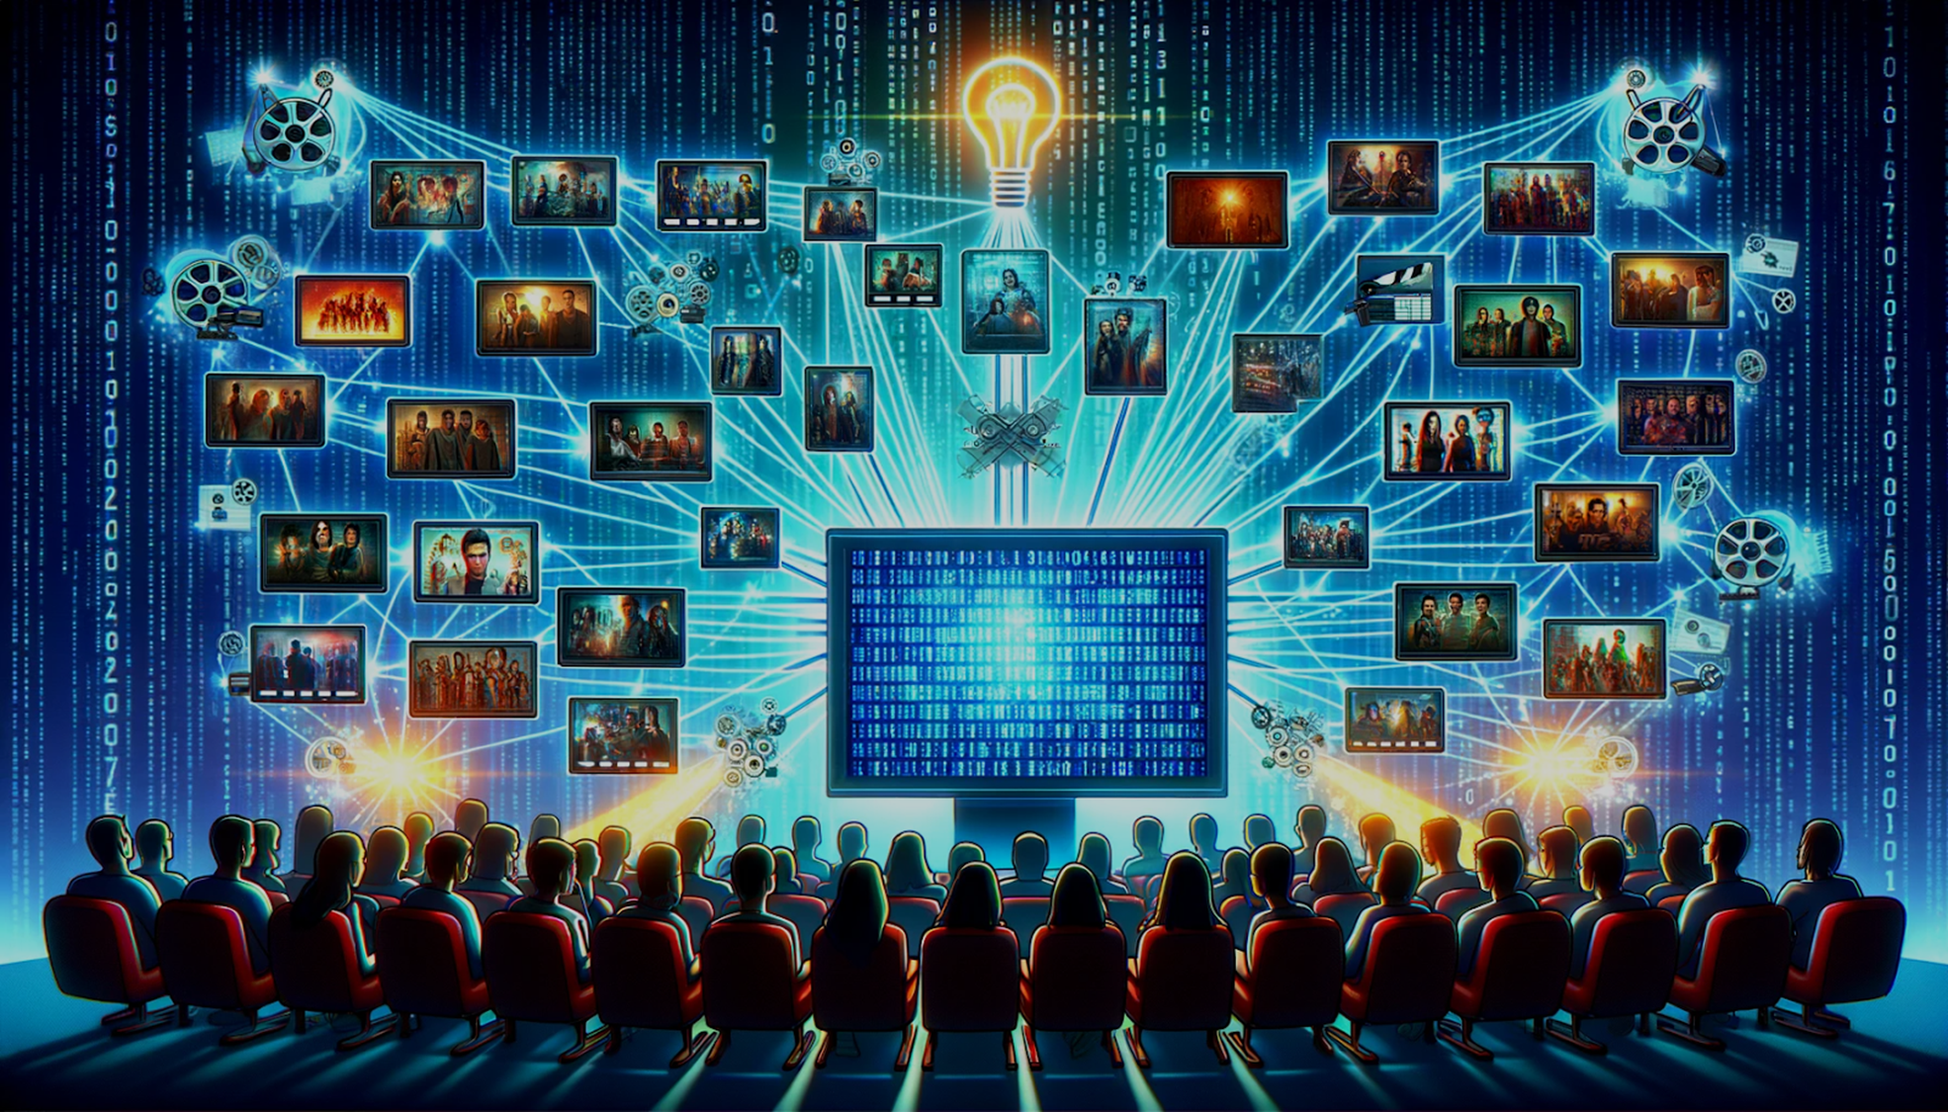
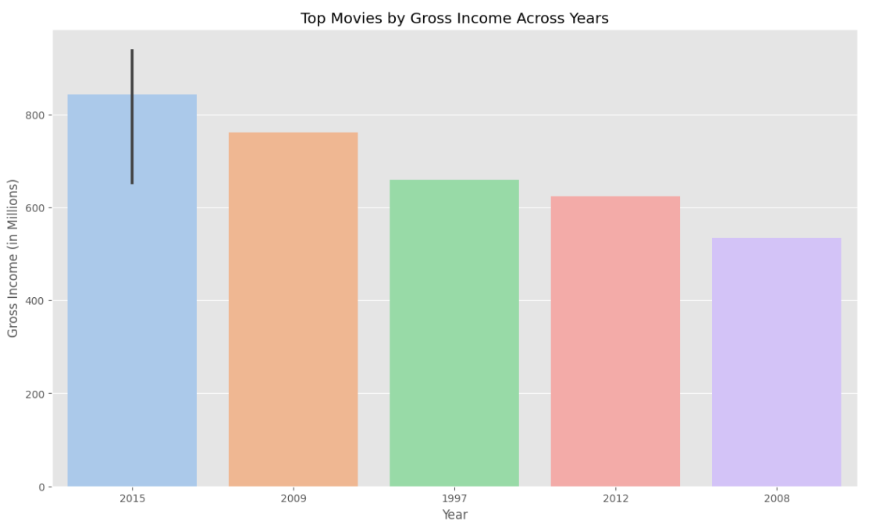
From this visualization we observed that the top movies by budget are released in the year 2015.

Slide 12
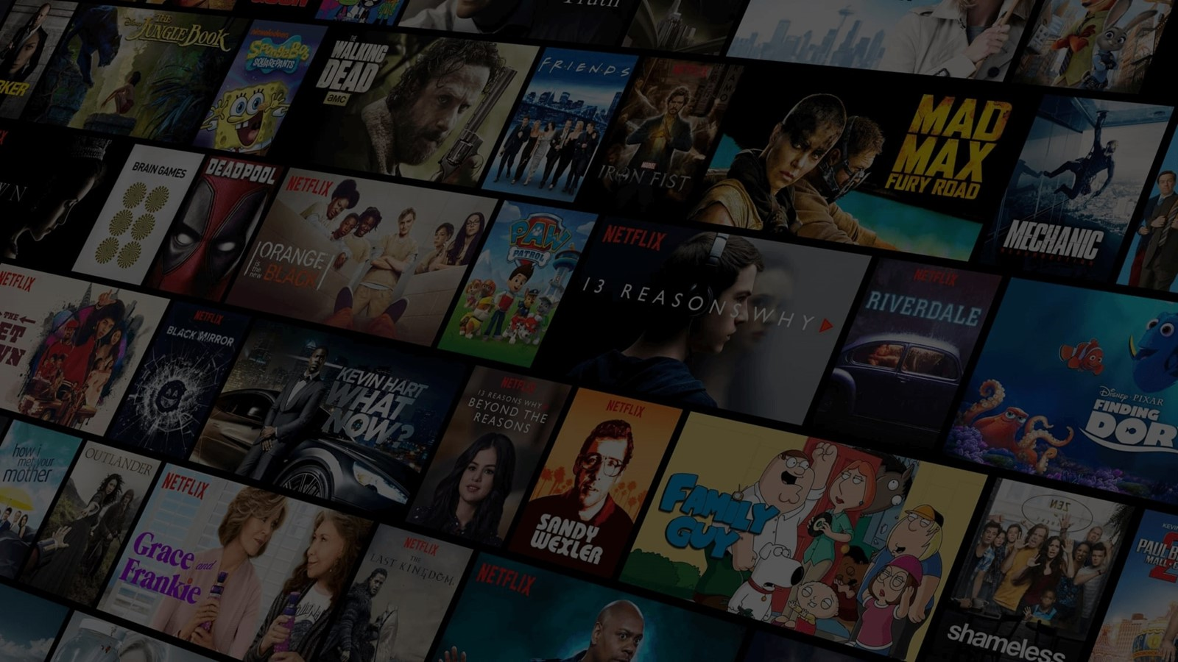
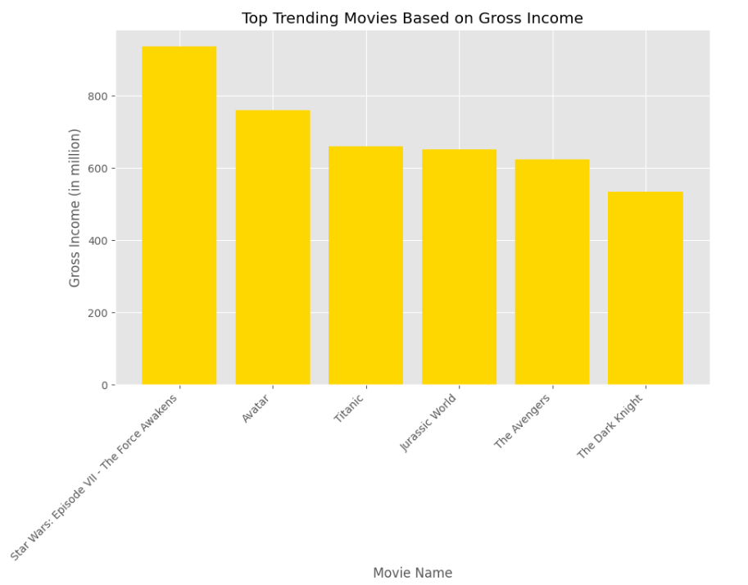
From this visualization we observed that the “Star wars : Episode VII – The Force Awakens” is the top trending movie based on gross income .

Slide 13

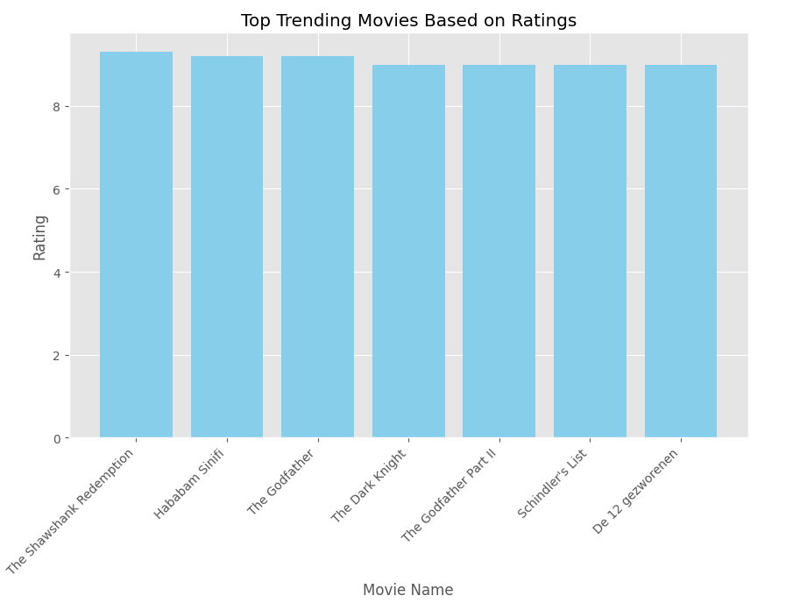
From this visualization we observed that “The Shawshank Redemption” is the top trending highest rated movie.

Slide 14

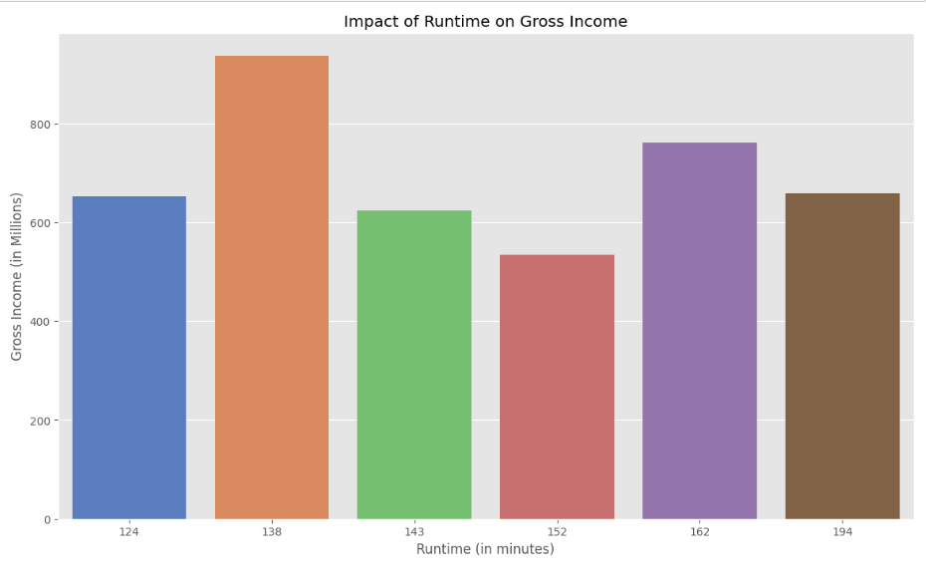
From this visualization we conclude that the most of the movies runtime 124 to 194 min and it has not much impact on gross income

Slide 15

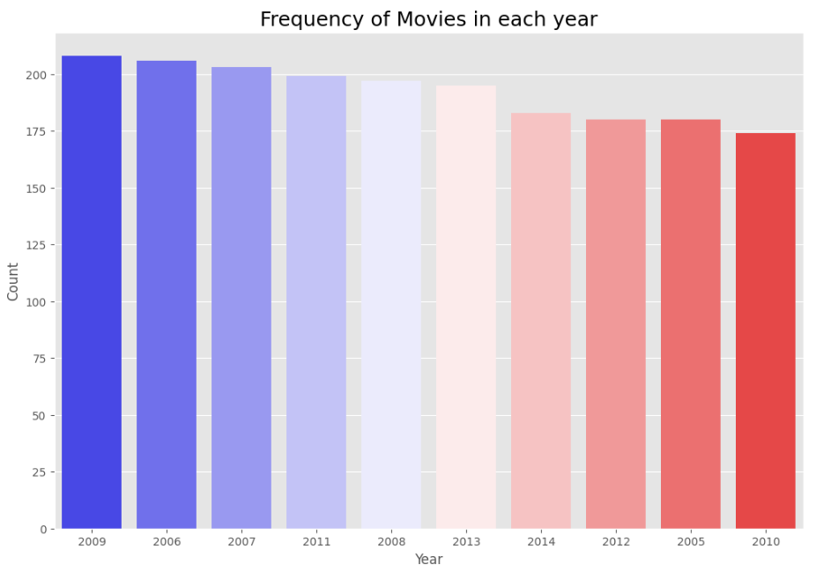
In this visualization we observed that the frequency of the movies in the year 2009 is high .

Slide 16

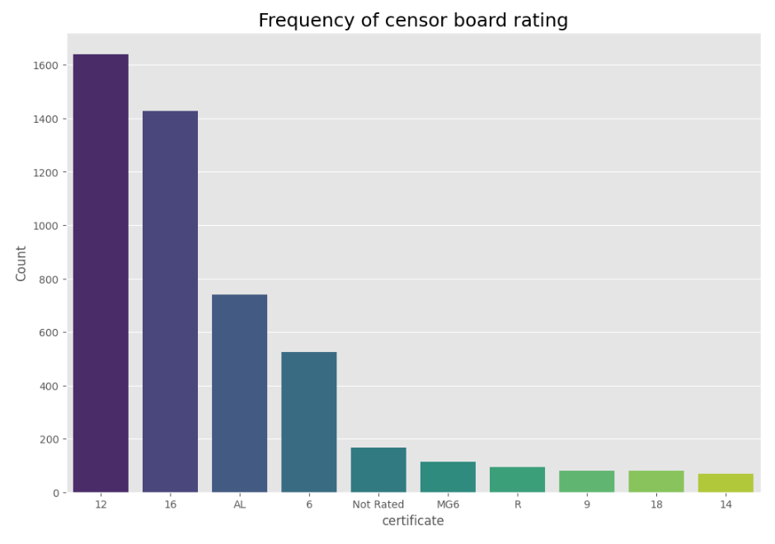
In this visualization we conclude that the frequency of movie certificate 12 is the highest

Slide 17

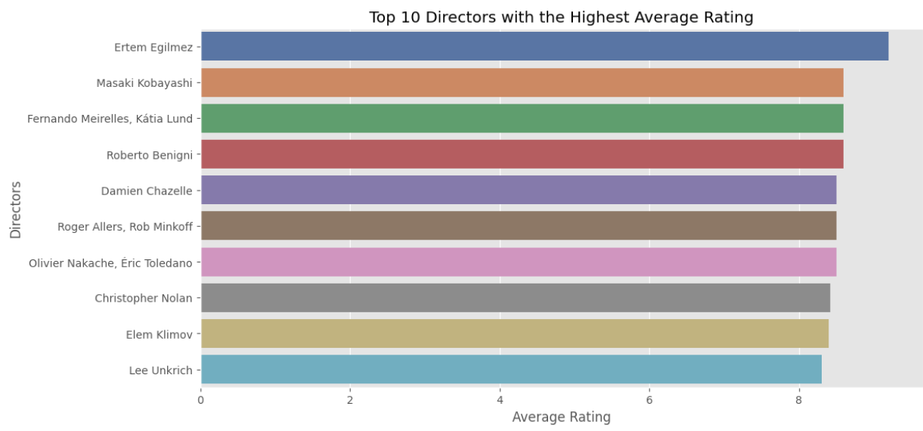
From this visualization we observed that the director “Ertem Egilmez” is the top director based on highest average rating around 9.0

Slide 18
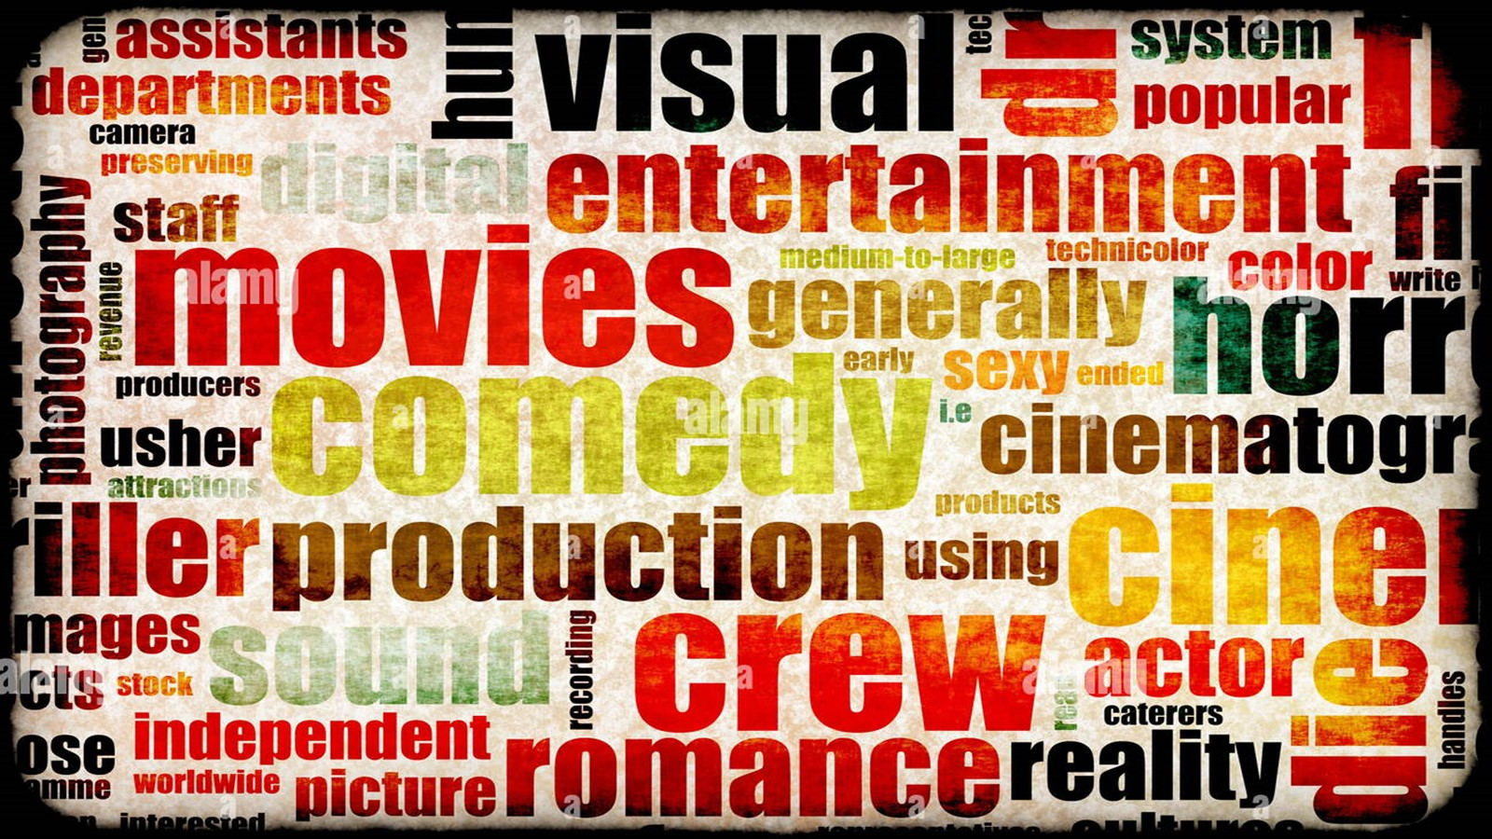
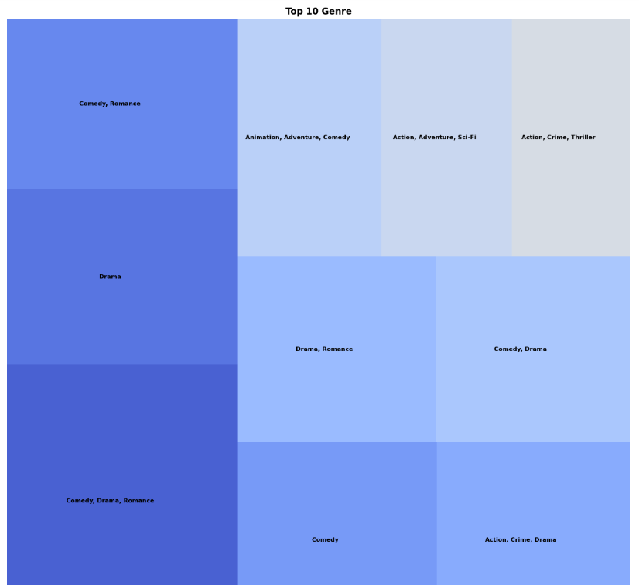
From this Chart we shows that , these are the Top 10 movie Genre.

Slide 19

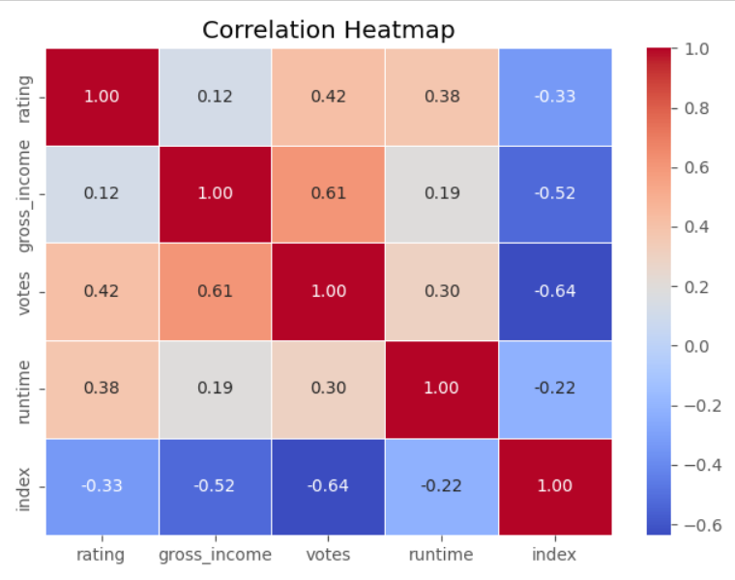
It indicates correlation percentage of all the features with respect to each other e.g gross income influence the runtime upto 19% and gross income is influence by votes upto 61%.
Intensity of colour increases along with influence of particular feature.

Slide 20
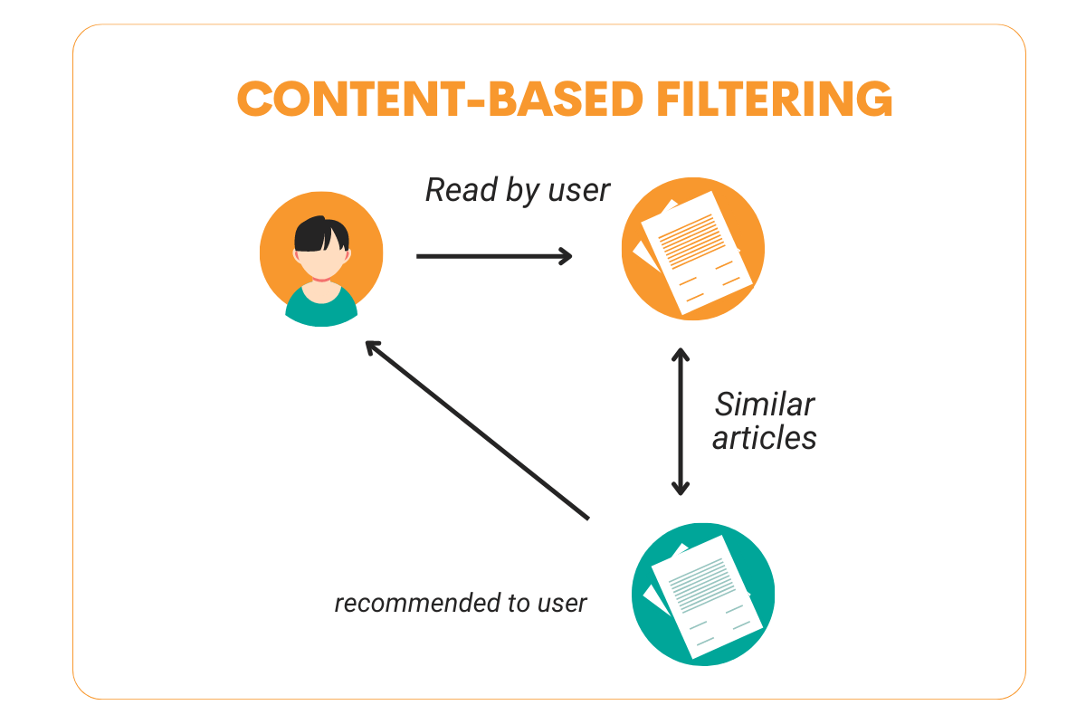
MODEL BUILDING
The recommendation system mainly classified into two types
Content – Based Filtering
Collaborative Based Filtering
In our project we use Content – Based Filtering because it is a recommendation system that suggests items to users based on their preference and past behaviour.

Slide 21

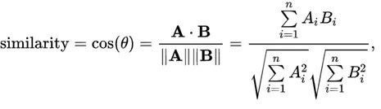
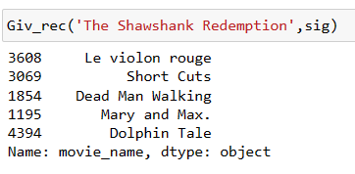
Import all the dependencies and load the scraped data.
The next step is to vectorize this feature to calculate similarity.
TF-IDF Vectorizer:
The TF (term frequency) is the number of times a given term occurs in a document.
The IDF (inverse document frequency) is the measure of how significant that term is in the whole
corpus.
Cosine Similarity:
The next step is to calculate the similarity between movies. We can use cosine similarity to calculate
the distance between two vectors.
Test our recommendation system:
Next we import Pickle library ,
because Pickle is a serialization/deserialization module that is already built-in in Python: using it we
can save an arbitrary Python object (with a few exceptions) to a file. Once we have a file, we can
load the model from there in a different process.

Slide 22
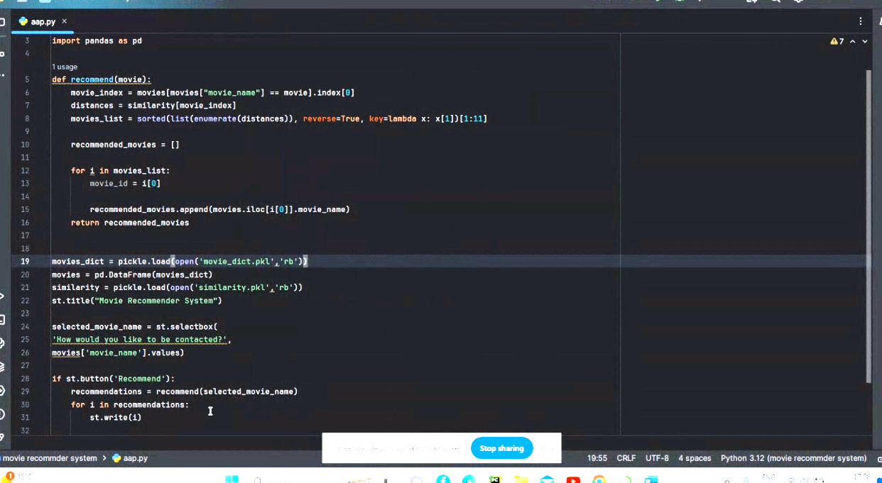
DEPLOYMENT
Here we use Streamlit for deploying our model because is an open-source Python library that makes it easy to build beautiful custom web apps for machine learning and data science.
Importance of making recommendations in realtime :
Recommender systems play a major role in today's ecommerce industry.
Recommender systems recommend items to users such as books, movies, videos, electronic products, etc.
Recommender systems help the users to get personalized Recommender system has the ability to predict whether a particular user would prefer an item or not based on the user's profile.
Link For deployment of model : Local URL: http://localhost:8501

Slide 23
CONCLUSION
A movie recommendation system is a tool that uses algorithms and data analysis to suggest movies to users based on their preferences and viewing history. The goal of such a system is to personalize the movie-watching experience and improve the chances of users finding movies like these.

Slide 24
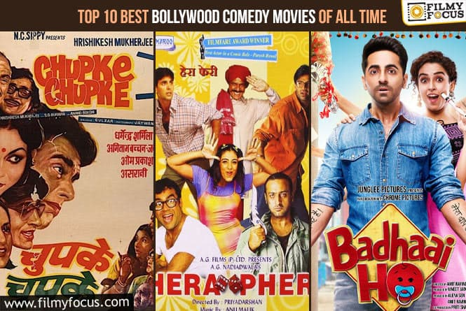

Slide 25


Slide 26
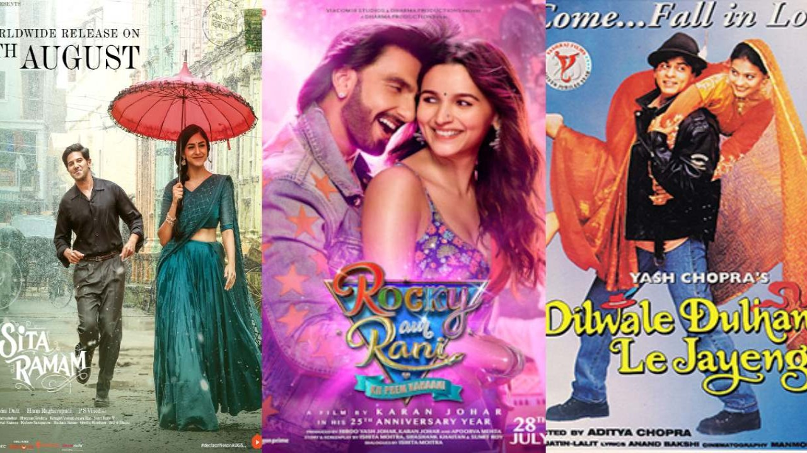

Slide 27


Slide 28

THANK YOU

